Slide 1
Gender Violence and Course and Curriculum Design: Performing a Feminist Pedagogy
Dr. Erika zimmermann damer
Dr. Mariela méndez
Dr. mari lee Mifsud
Program in women, gender, and sexuality studies
university of richmond

Slide 2
Infusing Gender Violence Studies into Curriculum Design
Conducting an Academic Program Review on Why and How to Make Gender Violence an Academic Requirement in WGSS Major/Minor:
Gathering WGSS Faculty for Roundtables
Gathering Students for Roundtables
Gathering an Energized Board for Meetings and Retreats
Gathering Resources
Hiring Visiting Scholars to advance the initiative
Dr. Debra Bergoffen, offering special topics seminars in “The Shame of Sexual Violence” and “Sexual Integrity as a Human Right” and hosting events to engage the study of Gender Violence:

Slide 3
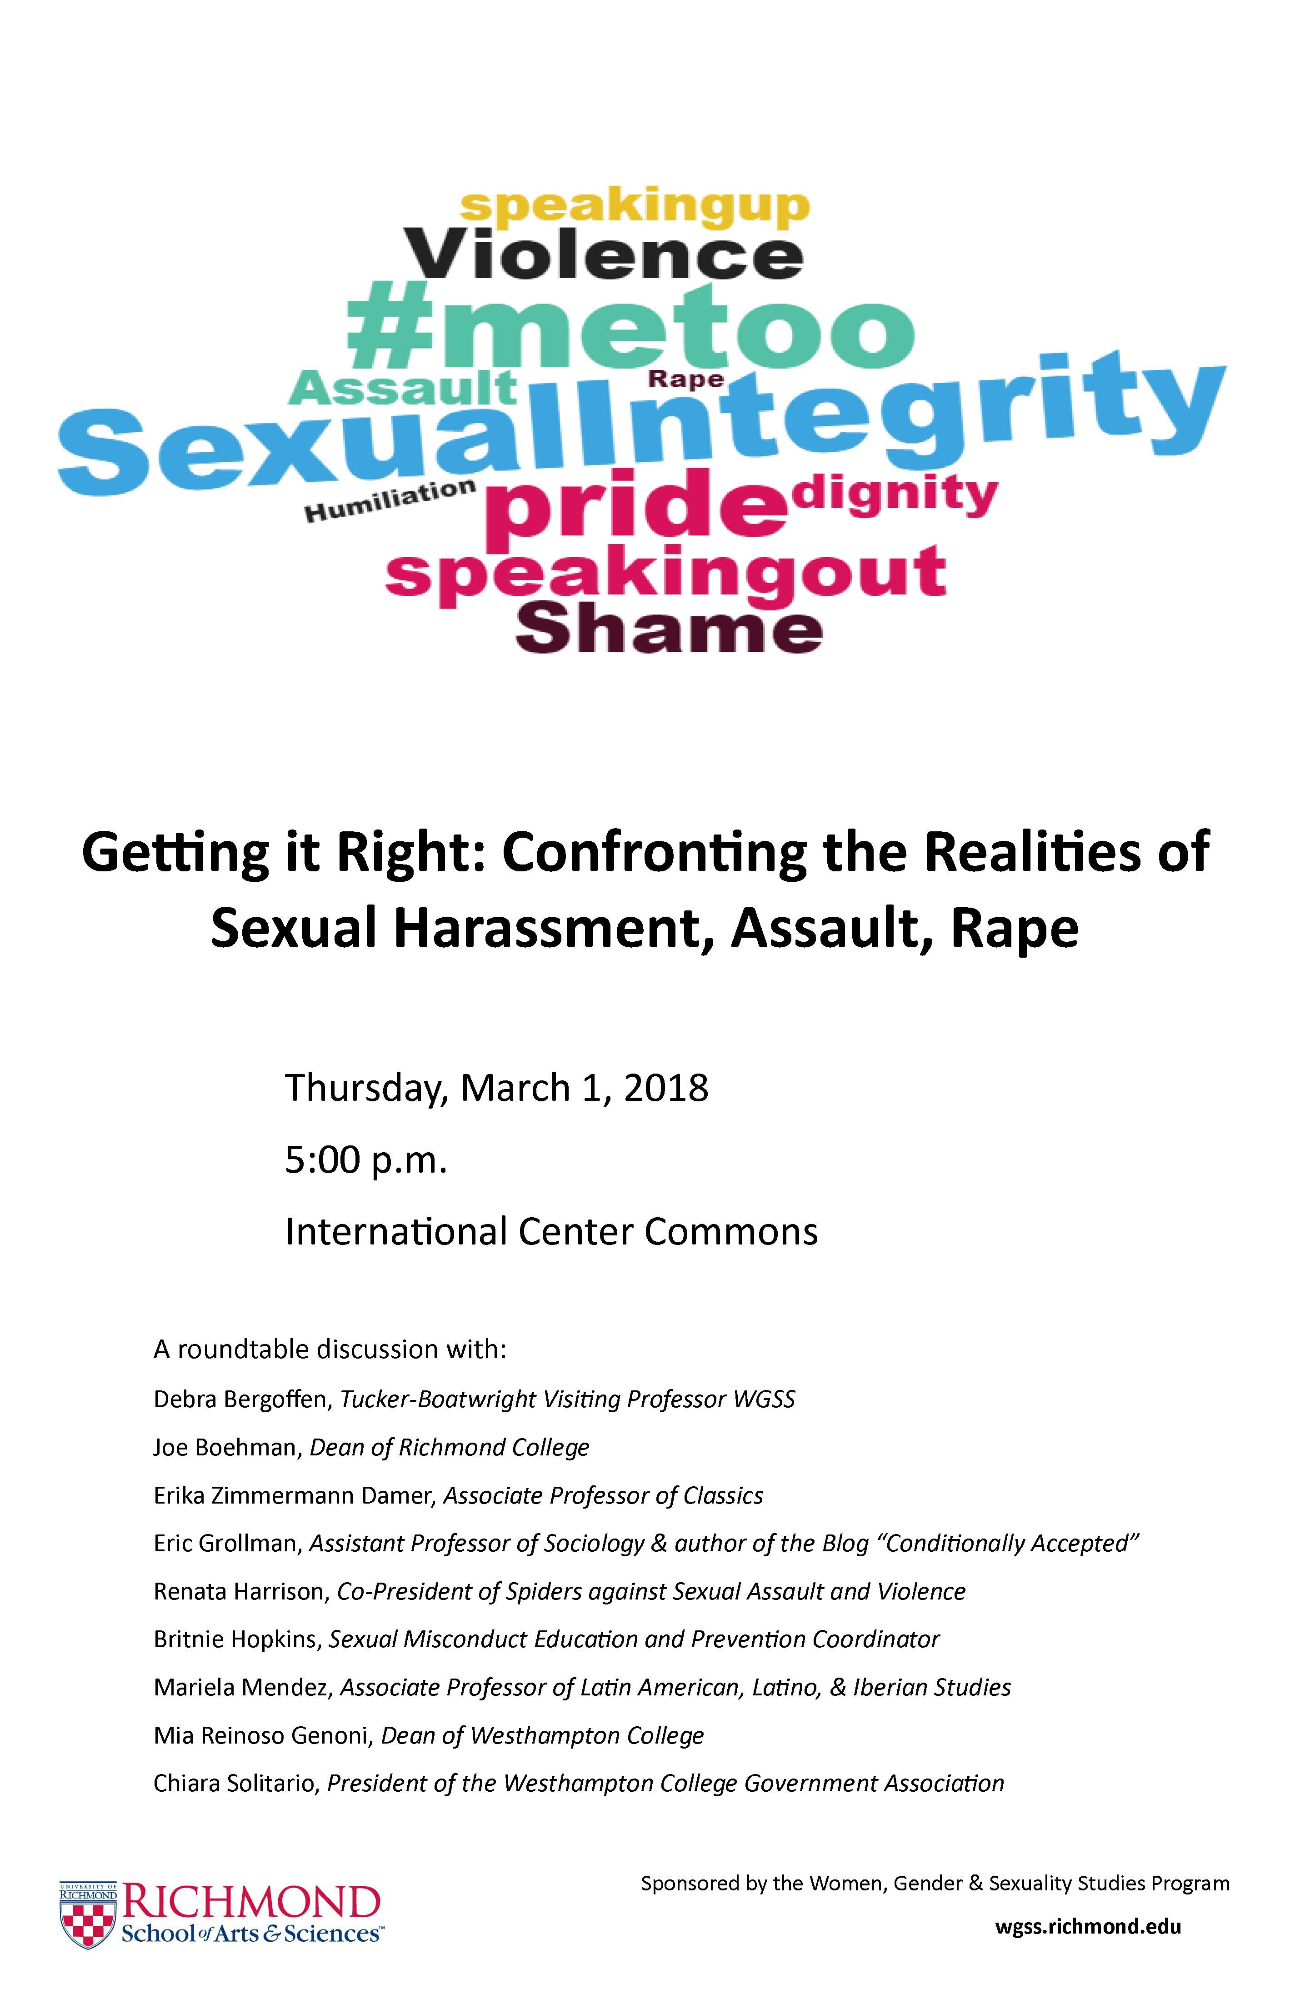
UR WGSS Gender Violence Events

Slide 4
Gender Violence Curriculum Development
Designing a Major Elective Requirement in Gender Violence
Inviting faculty to revise approved WGSS courses to focus on gender violence: https://docs.google.com/spreadsheets/d/1cOvvCa6Q8czYWKttwOCGatsR6F-4WGxMRaG2YxKQC2g/edit?usp=sharing
Developing New Courses in the Study of Gender Violence
Erika Damer, First Year Seminar, “Gender, Violence, Rome”
Mariela Méndez, LALIS 497/WGSS Cross Listed Course, “Embodied Politics of Latin America”
Mari Lee Mifsud, RHCS 412/WGSS Cross Listed Course, “Rhetorics of Gender Violence, Resistance, and Abolition”

Slide 5
Rhetoric and Communication Studies Seminar 412: Rhetorics of Gender Violence
Conducting a Media Audit of Gender Violence discourses
Charting the Meta Data of the Media Audit https://docs.google.com/spreadsheets/d/1sS5dfuNFfoQsIoFih8iXusOau7qsWY_Nl8zCwTdAPBg/edit?usp=sharing
Reading Mary Beard’s Women & Power: A Manifesto; Kate Manne’s Down Girl: The Logic of Misogyny; Sara Ahmed, Living a Feminist Life; Cixous, “Sorties,” and “Laugh of Medusa"
Discerning tropes of Gender Violence, Resistance, and Abolition in both the Gender Violence Media Audit and Beard, Manne, Ahmed, Cixous.
Creating a way to exhibit Rhetorics of Gender Violence, Resistance, and Abolition in a public forum

Slide 6
First Year Seminar Gender, Violence, Rome

Slide 7
Latin American, Latino, Iberian Studies 497: Embodied Politics in Latin America
A repertoire of embodied practices that grapple with the tensions between socially inscribed corporeal regulation and the imaginative and political possibilities of the performative.
Two-fold analysis: the alarming rates of femicides and travesticides throughout Latin America, and the sexual assault crisis on college campuses.
Reading Marcela Lagarde’s coinage of the term ”femicide” and Rita Segato’s analysis of the femicides in Ciudad Juárez, México.
Enacting embodied forms of knowing and resisting.
A pedagogy of care, shared experiences, and community building.

Slide 8
Protest & Resistance through Performance
https://www.luchadoras.mx/
Ni Una Menos & “Operación Araña” (”Operation Spider”)
https://www.facebook.com/comunicacion.emergentes/videos/1048052255358313/
Melissa Lozada-Oliva – “My Spanish”
https://www.youtube.com/watch?v=fE-c4Bj_RT0
Mónica Mayer & “El Tendedero” (“The Clothesline”)
https://www.againstviolence.art/?fbclid=IwAR0CQuBL11yMUAoq1Kp1Dcah47ACdvf08zFId2WKcsVYQ9ibx-48ehEib7U
https://www.lanacion.com.ar/2149900-el-tendedero-una-performance-feminista-se-instala-hoy-en-la-puerta-del-malba?fbclid=IwAR133UmAEVMVn78mYXD8XjqHs19EXNK6AvfR6eL5QxfGpOBy0-HyaRhwmLk
Others:
https://www.facebook.com/sinmediosweb/videos/1954595781470306/
https://www.facebook.com/NowThisHer/videos/1368415646622640/

Slide 9
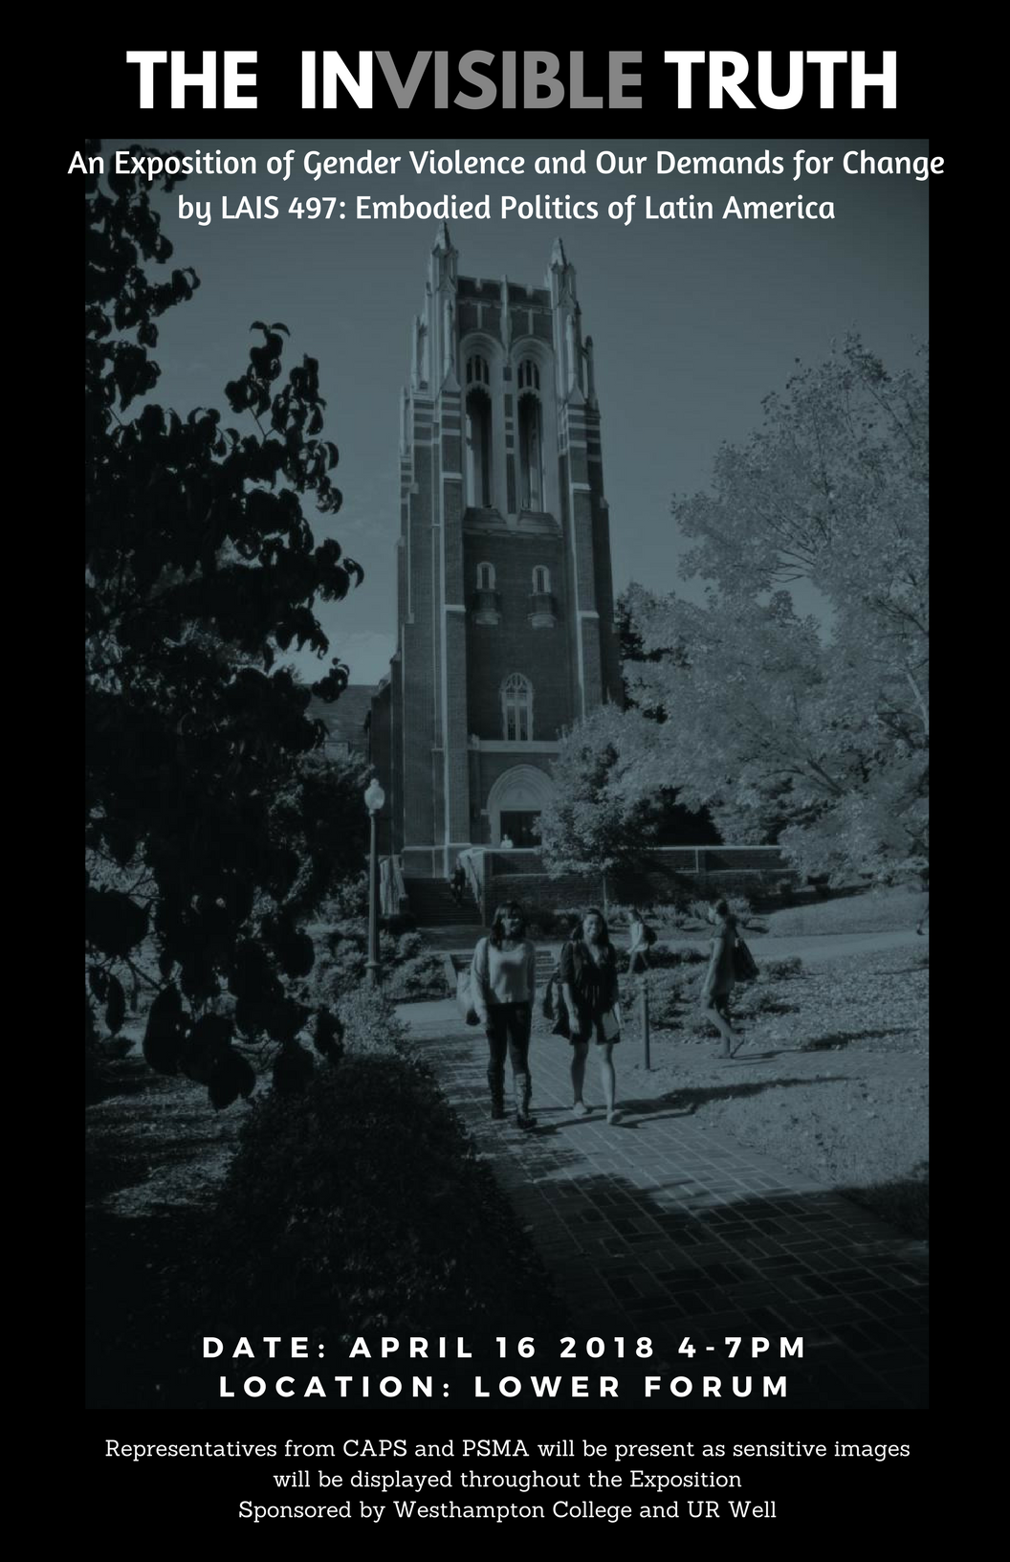
Digital Archive
https://scholarship.richmond.edu/invisibletruth/

Slide 10
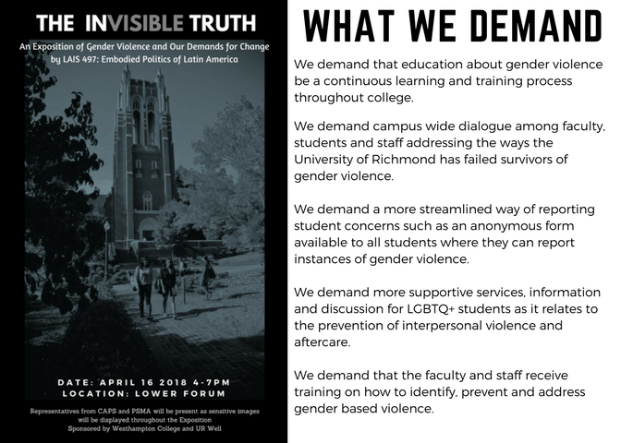
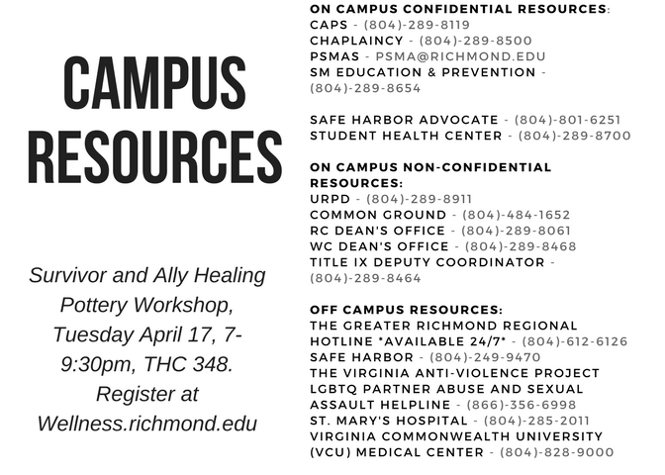
Manifesto: Our Demands for Change

Slide 11
Feminist Pedagogy Rhetorics of Gender Violence
Collaborative Creation of Knowledge:
What is Gender? What is Violence? What rhetorics--text, context, artifacts, media, design, and technical, professional, corporate, political, legal, cultural, discourses—enable gender violence, resist gender violence, work to abolish the conditions of possibility for gender violence?
Equitable Power/Labor Distribution in Creating Knowledge
Oriented to both Academic and Public Scholarship
Intersectional Focus on Power and Justice
Collective Determination to Abolish Gender Violence

Slide 12
Working Bibliography: Gender Violence
https://docs.google.com/document/d/1n7zfsFbhBqzNkdfycozMDcF8YOmQ_fPRgnD2dK78myg/edit?usp=sharing
These slides are posted at github.com/erika-zimmermann-damer/Lesley-University-Violence-against-Women-conference

